Slide 1


Submitted By : Shubham Sourabh BTECH/15044/18 CSE 6th Sem Guided By : Mr. Sujit Kumar Chatterjee Sir
Birla Institute of Technology, Mesra, Patna Campus
Project Title : Zaynify- A Music Web APP
Department of Computer Science and Engineering

Slide 2
Contents
Objective
Introduction
Tools and Technologies
Methodologies
Snapshots
Conclusion
References
Department of Computer Science and Engineering

Slide 3
Objective
To design a full-fledged dynamic web-Music Player.
Being a music guy I always looked music players that can help me with my needs like custom playlist , great UI and etc but alas there’s none.
Being a CS Student I decided this summer why not to create one which matches my taste.
Department of Computer Science and Engineering

Slide 4
Introduction
This Music Player App is a web application that is made using HTML,CSS,JS&Bootstrap for Front-end part and for Backend Django is used .
The sole purpose for making this app was to provide user to store their own kind or taste of music or songs with good features.
User can save and store their music through backend page powered by Django, Hassle-free.
Department of Computer Science and Engineering

Slide 5
Tools and Technologies
Sublime Text 3 (Text editor), Ms-Terminal, Virtual Environment, Python Packages and some plugins.
Bootstrap - Bootstrap is a free and open-source CSS framework. The primary purpose of adding it to a web project is to apply Bootstrap's choices of color, size, frontend layout to that project.
Django - Django is a high-level Python Web framework that encourages rapid development and clean, pragmatic design.
Department of Computer Science and Engineering

Slide 6
Methodology
MVT Architecture
MVT (Model View Template) is a software program layout sample that’s a group of 3 elements: Model, View, and Template. The Model allows dealing with the database. It is a data access layer that handles the information in the database.
The Template is a presentation layer that handles all the User Interface parts. The View executes the logic and interact with the model to carry data and renders the template.
In the MVT architecture, a user sends a request for a resource to Django, Django works as a controller and checks for the available resource in the URL.
If a URL is mapped, a view is called that interact with the model and template, it renders a template.
Django responds to the user and sends a template as a response.
Department of Computer Science and Engineering

Slide 7
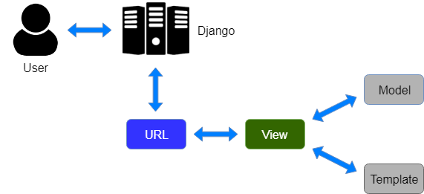
Methodology
MVT Architecture
Here is an easy diagram that indicates the MVT structure in Django:
Department of Computer Science and Engineering

Slide 8
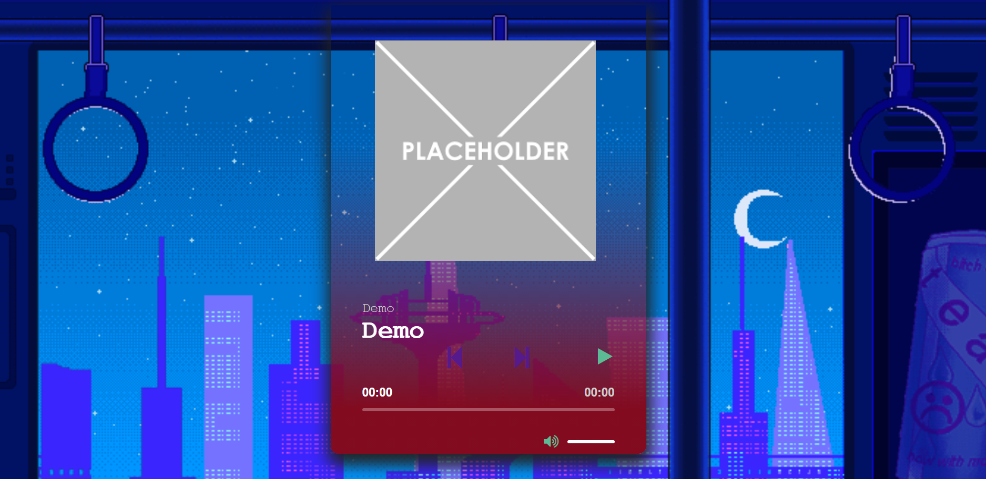
Screenshots
Fig 1. Home Page
Department of Computer Science and Engineering

Slide 9
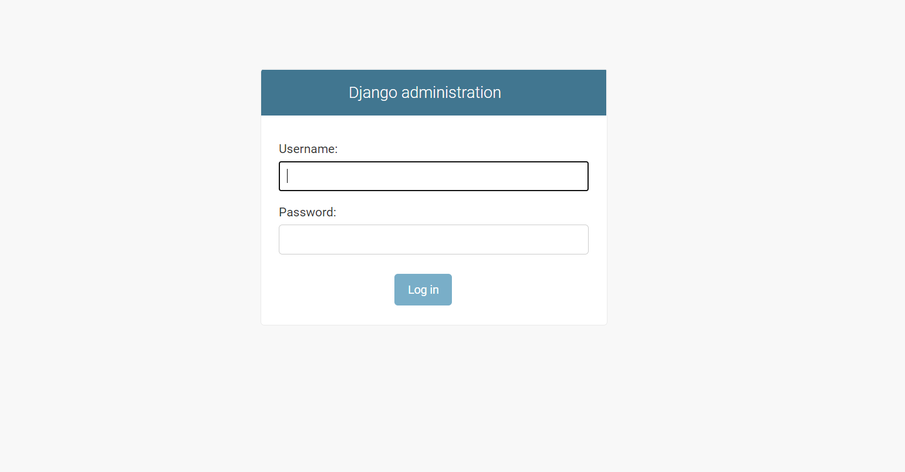
Fig 2. Login Using Django Site Administrator to access our backend
Department of Computer Science and Engineering

Slide 10
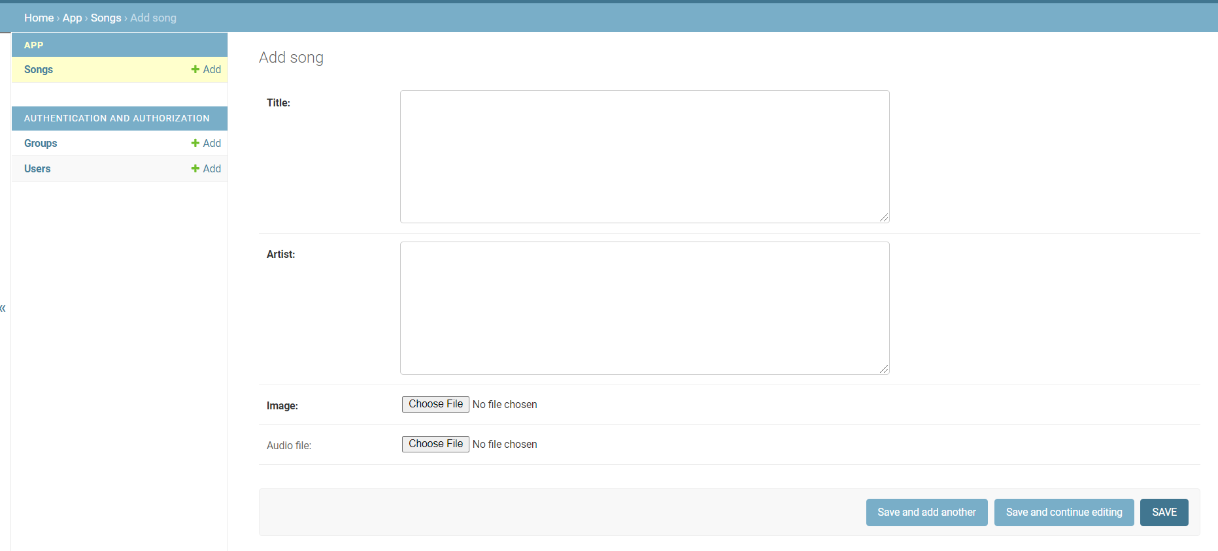
Fig 3. Backend page to add a song.
Department of Computer Science and Engineering

Slide 11
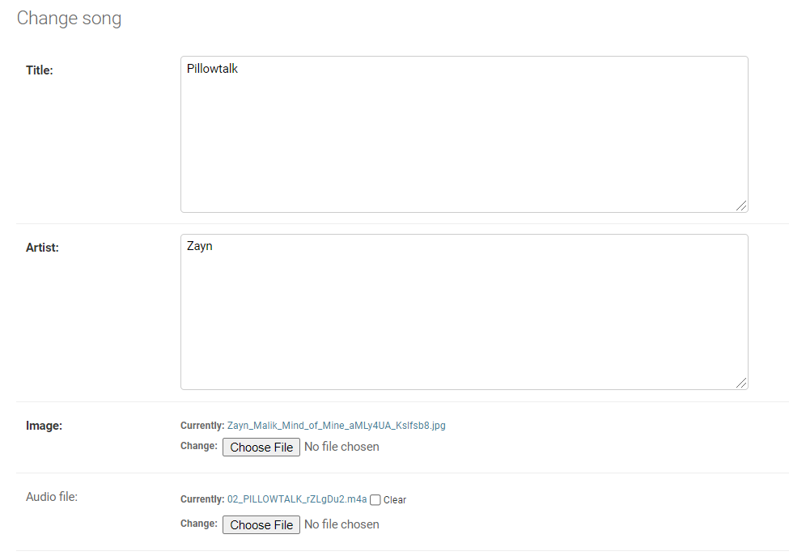
Fig 4. Adding a song .
Department of Computer Science and Engineering

Slide 12
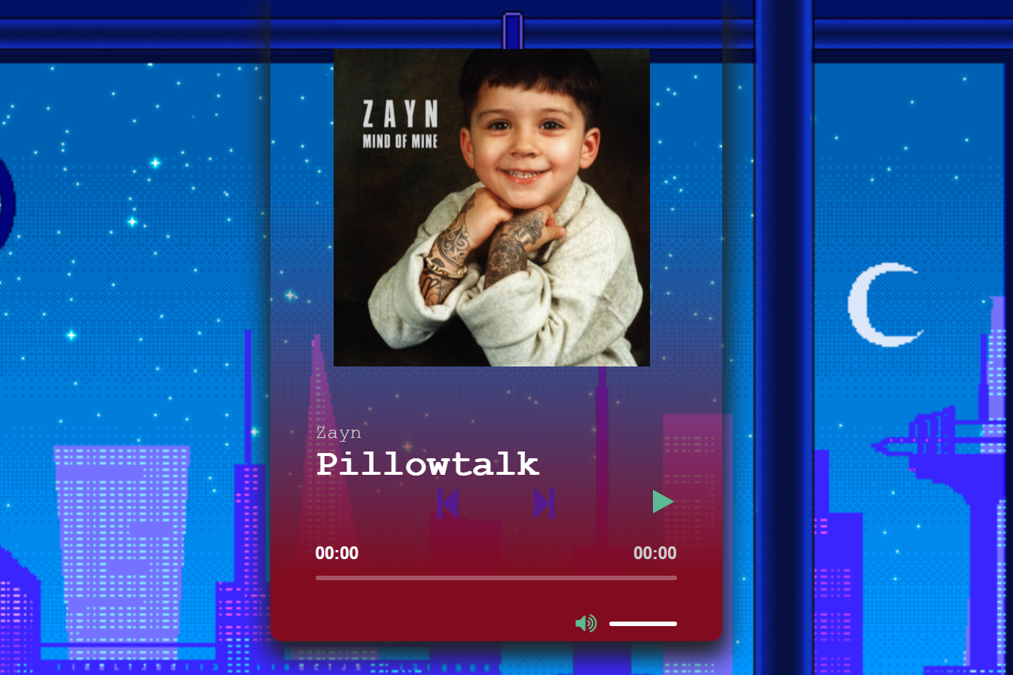
Fig 5. Homepage after adding song (we can )
Department of Computer Science and Engineering

Slide 13
Conclusion
The project has discussed about the development of Full fledged working of a music web app .
Upon the completion of this project , i got the thorough knowlegde of Python,about Frameworks, Django, Bootstrap etc .
There were certain difficulties while intergrating backend to frontend,scalability issues, and many small issues as well but after the completion of the project, i not only got to know how to come over those problems but also how to handle with em.
I learned how to use CLi’s like CMD,Powershell. Creating Virtualenv and activating them and installingpackages into Enviroment etc
Department of Computer Science and Engineering

Slide 14
References
For Python :- https://www.python.org/
For Django:- https://www.djangoproject.com/
ForBootstrap:-https://getbootstrap.com/docs/3.4/gettingstarted/
Department of Computer Science and Engineering

Slide 15


